Slide 1
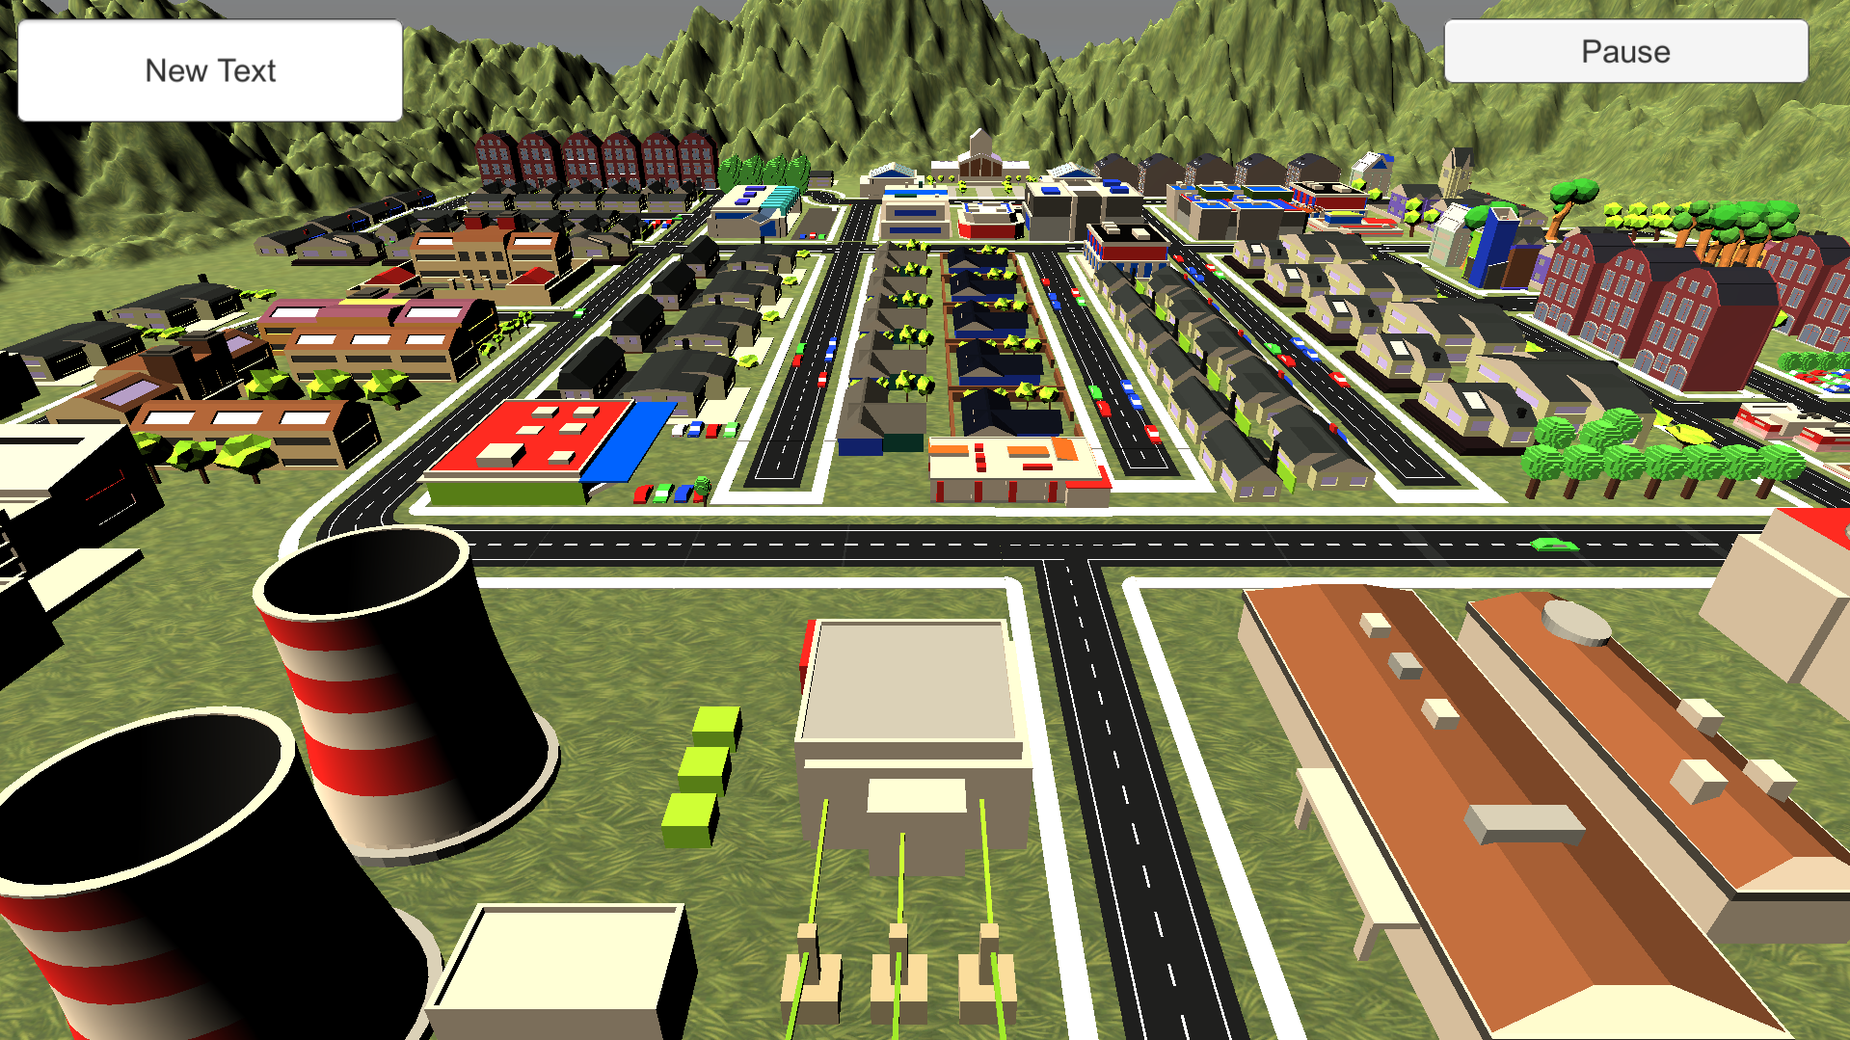
Player: Sam Score: 500
Buy Workers
Price: 10000$
Buy
2 / 3
$ 50000
☹ ☺

